Slide 1


<Dan Marks>
<January 8th, 2026>

Slide 2

Outline
Executive Summary
Introduction
Methodology
Results
Conclusion
Appendix

Slide 3
Executive Summary - Methodologies
This project analyzed publicly available SpaceX Falcon 9 launch data to understand the factors influencing first-stage landing success and to build a predictive model for booster reuse.
Summary of methodologies:
Collected Falcon 9 launch data from the SpaceX REST API and supplemented it with launch records scraped from Wikipedia.
Cleaned and transformed the data using pandas, and converted landing outcomes into binary labels for modeling.
Performed exploratory analysis using Python visualizations (Matplotlib/Seaborn) and SQL queries in a DB2 database.
Built interactive visualizations using Folium maps and a Plotly Dash dashboard.
Trained and tuned multiple classification models using GridSearchCV and selected the best-performing model based on accuracy.

Slide 4
Executive Summary - Results
Summary of results:
Launch success rates increased steadily from 2013 to 2020.
Sites with more launch history generally achieved higher success rates.
Orbits ES-L1, GEO, HEO, SSO, and VLEO showed the highest success rates.
KSC LC-39A had both the highest number of successful launches and the highest success rate overall.
Payloads between 2,000 and 5,500 kg achieved the highest success rates.
The Decision Tree classifier performed best, with good class separation and a small number of false positives.

Slide 5
Introduction
The commercial space era is underway, with companies like Virgin Galactic, Blue Origin, and SpaceX working to make space travel more accessible.
Among them, SpaceX stands out due to its ability to reuse the rocket’s first stage, which significantly reduces launch costs. Since the first stage performs most of the work during launch, it is also the most expensive component. Because of this, predicting whether the first stage will successfully land and be reused is key to estimating the cost of a launch.
Space-Y is an emerging competitor aiming to challenge SpaceX’s cost advantage. In this project, we estimate launch prices by analyzing publicly available SpaceX data.
We use dashboards for exploration and train a machine learning model to predict whether the first stage will be reused.

Slide 6

Section 1

Slide 7
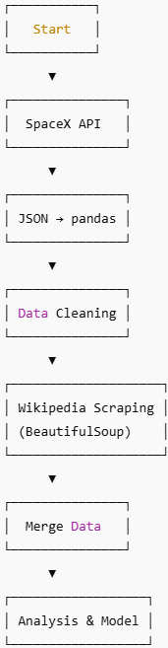
Data Collection
Launch data was collected from the SpaceX REST API and supplemented with Falcon 9 launch tables scraped from SpaceX’s Wikipedia pages to ensure complete coverage.
API responses were converted from JSON into pandas DataFrames and cleaned for missing values and consistency.
Wikipedia tables were parsed using BeautifulSoup to capture additional details such as customer information and booster landing results.
The combined dataset was then used for analysis and modeling.

Slide 8
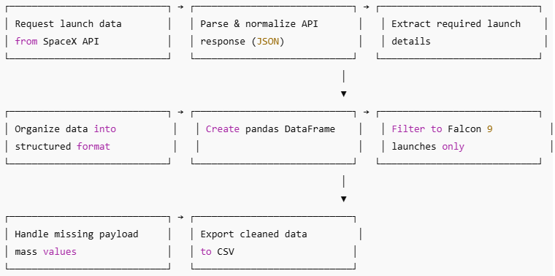
Data Collection – SpaceX API
Collected data from the SpaceX API using GET requests, then cleaned, formatted, and performed basic data wrangling.
GitHub URL: https://github.com/plotEZ/IBM-Applied-Data-Science-Capstone/blob/main/Data_Collection_API.ipynb

Slide 9
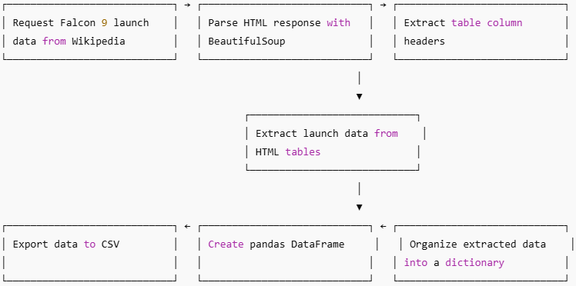
Data Collection - Scraping
Scraped Falcon 9 launch data from the web using BeautifulSoup and converted the tables into a pandas DataFrame.
GitHub URL: https://github.com/plotEZ/IBM-Applied-Data-Science-Capstone/blob/main/Data_Collection_with_Web_Scraping.ipynb

Slide 10
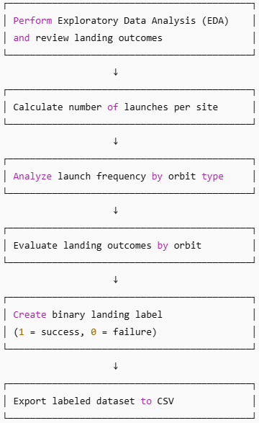
Data Wrangling
The dataset includes several booster landing outcomes based on whether a landing was attempted and where it occurred. Some landings were successful, while others failed due to accidents or missed targets.
For ocean landings, True Ocean indicates a successful landing, while False Ocean indicates a failed attempt. True RTLS and False RTLS represent successful and failed ground pad landings, respectively. True ASDS and False ASDS indicate successful and failed drone ship landings.
For modeling purposes, these outcomes are converted into binary training labels: 1 for a successful landing and 0 for an unsuccessful landing.
GitHub URL: https://github.com/plotEZ/IBM-Applied-Data-Science-Capstone/blob/main/Data_Wrangling.ipynb

Slide 11
EDA with Data Visualization
Created charts to explore relationships between flight number, payload mass, launch site, orbit type, and mission success
Used scatter plots to identify relationships between continuous variables and potential predictors
Used bar charts to compare outcomes across discrete categories (e.g., launch sites and orbit types)
Used line charts to examine trends in success rates over time
GitHub URL: https://github.com/plotEZ/IBM-Applied-Data-Science-Capstone/blob/main/EDA_with_Data_Visualization.ipynb

Slide 12
EDA with SQL
SQL-Based Exploratory Data Analysis
Loaded the SpaceX dataset into a DB2 database
Used SQL queries to explore and summarize the data
Key analyses included:
Identifying unique launch sites and filtering sites by name patterns
Calculating total and average payload mass by customer and booster version
Summarizing successful vs. failed mission outcomes
Identifying the first successful ground pad landing date
Analyzing drone ship landings by payload range, booster version, and launch site
Identifying booster versions that carried the maximum payload
Ranking landing outcomes over a selected time period
GitHub URL: https://github.com/plotEZ/IBM-Applied-Data-Science-Capstone/blob/main/EDA_with_SQL.ipynb

Slide 13
Build an Interactive Map with Folium
Displayed all launch sites on an interactive map using markers and overlays
Labeled launches by outcome (1 = success, 0 = failure)
Used color-coded markers to highlight sites with higher success rates
Analyzed distances between launch sites and nearby features, such as coastlines, highways, railways, and cities
GitHub URL: https://github.com/plotEZ/IBM-Applied-Data-Science-Capstone/blob/main/Interactive_Visual_Analytics_with_Folium.ipynb

Slide 14
Build a Dashboard with Plotly Dash
Added a dropdown menu to allow users to select a launch site
Included a pie chart to display overall launch success, or success vs. failure for a selected site
Added a slider to filter launches by payload mass range
Created a scatter plot to explore the relationship between payload mass and launch success across booster
GitHub URL: https://github.com/plotEZ/IBM-Applied-Data-Science-Capstone/blob/main/spacex_dash_app.py

Slide 15
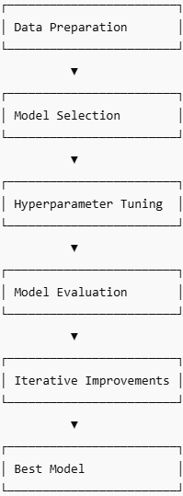
Predictive Analysis (Classification)
Loaded and prepared the data using NumPy and pandas, including feature transformations and train/test splitting
Built multiple classification models and tuned hyperparameters using GridSearchCV
Evaluated model performance using accuracy and improved results through feature engineering and model tuning
Selected the best-performing classification model
GitHub URL: https://github.com/plotEZ/IBM-Applied-Data-Science-Capstone/blob/main/Machine_Learning_Prediction.ipynb

Slide 16

Section 2

Slide 17
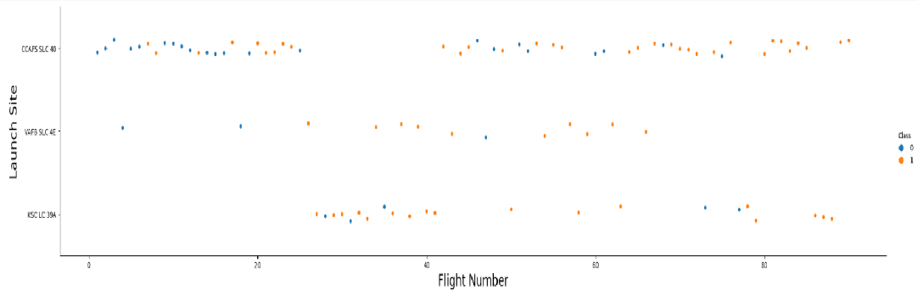
Flight Number vs. Launch Site
The plot shows that launch sites with a higher number of flights tend to have higher success rates.

Slide 18
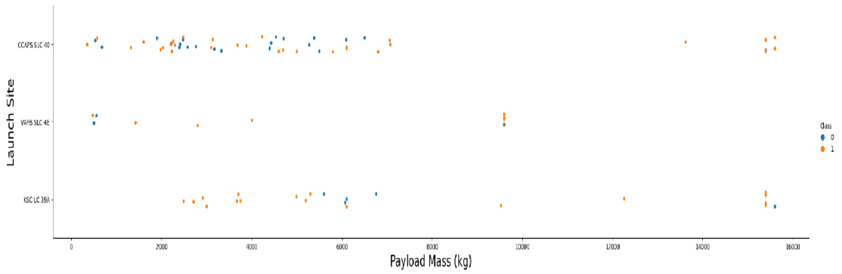
Payload vs. Launch Site
The plot indicates that for launch site CCAFS SLC 40, higher payload masses are associated with higher rocket success rates.

Slide 19
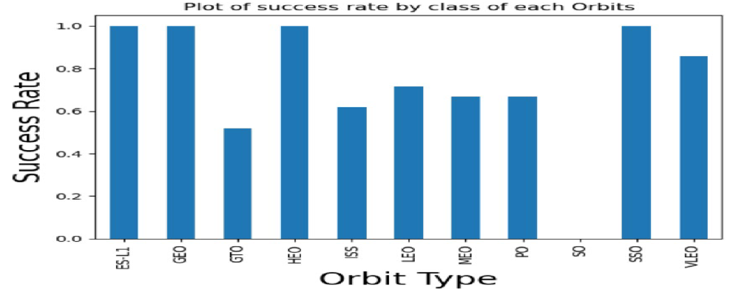
Success Rate vs. Orbit Type
ES-L1, GEO, HEO, SSO, and VLEO show the highest success rates.

Slide 20
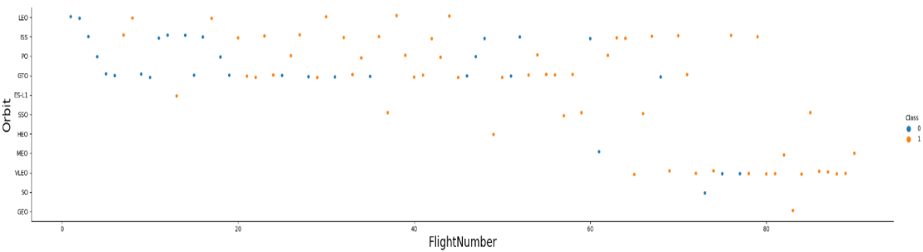
Flight Number vs. Orbit Type
The plot shows that in LEO, success is related to the number of flights, while in GTO there is no clear relationship between flight number and success

Slide 21
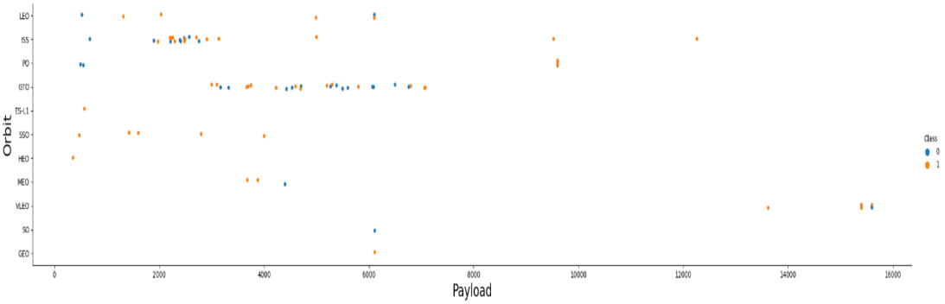
Payload vs. Orbit Type
The plot suggests that heavier payloads are associated with higher landing success rates for PO, LEO, and ISS orbits.

Slide 22
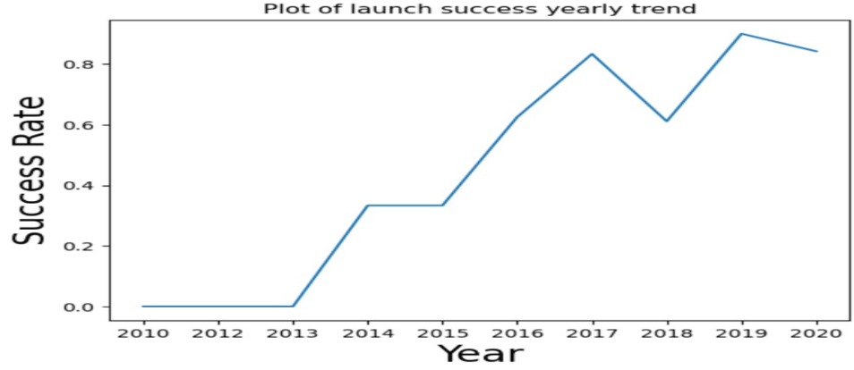
Launch Success Yearly Trend
The plot shows that launch success rates increased steadily from 2013 through 2020, with minor fluctuations.

Slide 23
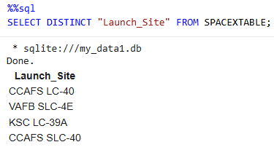
All Launch Site Names
Used the DISTINCT keyword to retrieve unique launch sites from the SpaceX dataset.

Slide 24
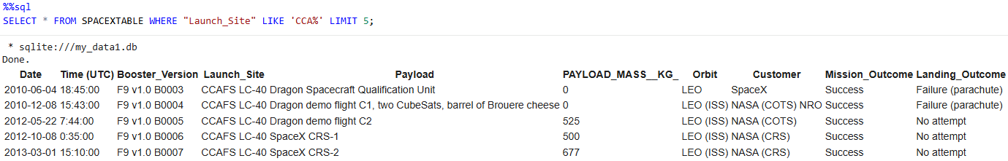
Launch Site Names Begin with 'CCA'
Used the LIKE keyword to identify launch sites starting with “CCA” and applied LIMIT to display the top five results.

Slide 25
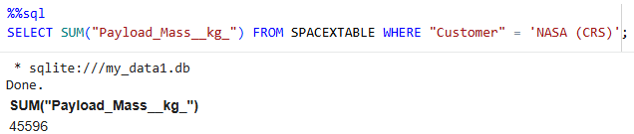
Total Payload Mass
Calculated the total payload mass carried for NASA missions as 45,596 using the query below.

Slide 26
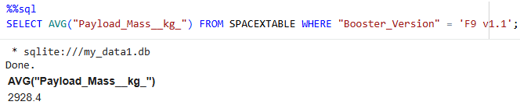
Average Payload Mass by F9 v1.1
Calculated the average payload mass for booster version F9 v1.1 as 2,928.4

Slide 27
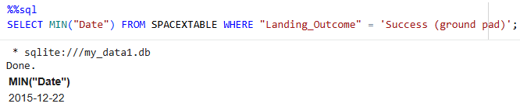
First Successful Ground Landing Date
Identified December 22, 2015 as the date of the first successful ground pad landing.

Slide 28
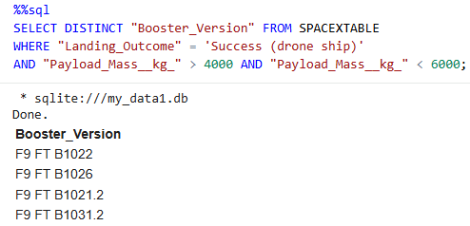
Successful Drone Ship Landing with Payload between 4000 and 6000
Used a WHERE clause with an AND condition to identify boosters that successfully landed on a drone ship with payload masses between 4,000 and 6,000.
The corresponding booster versions are listed below.

Slide 29
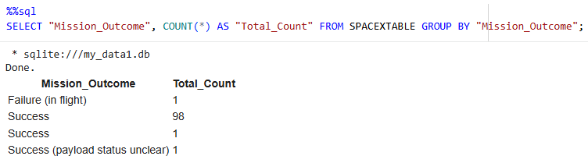
Total Number of Successful and Failure Mission Outcomes
Listed the total counts of successful and failed mission outcomes.

Slide 30
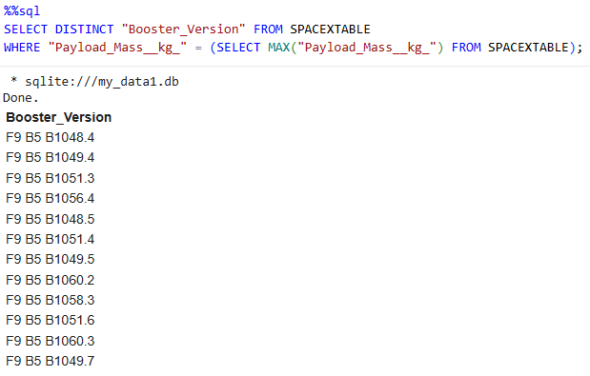
Boosters Carried Maximum Payload
Identified the booster that carried the maximum payload using a subquery with the MAX() function.

Slide 31
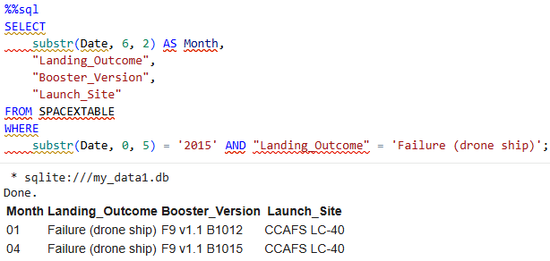
2015 Launch Records
Listed failed drone ship landings in 2015, along with their booster versions and launch site names.

Slide 32
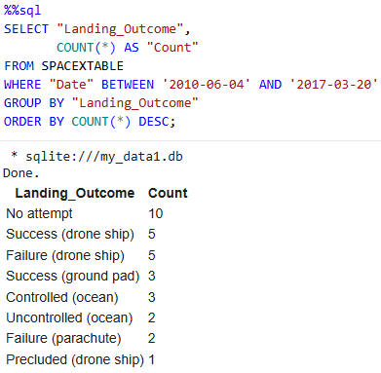
Rank Landing Outcomes Between 2010-06-04 and 2017-03-20
Ranked landing outcomes (e.g., drone ship failures and ground pad successes) between 2010-06-04 and 2017-03-20 in descending order.

Slide 33

Section 3

Slide 34
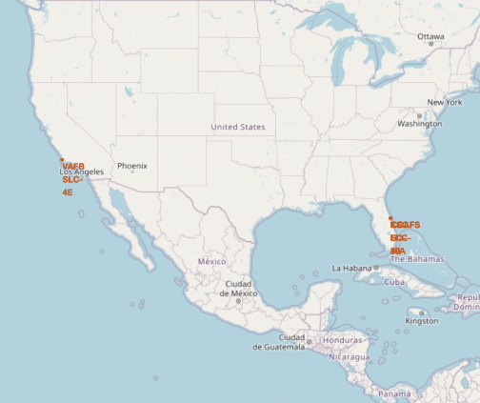
All Launch Sites – Global Map Marker
All launch sites are located close to the coastline, allowing launches over the ocean and reducing the risk of debris impacting populated areas.

Slide 35
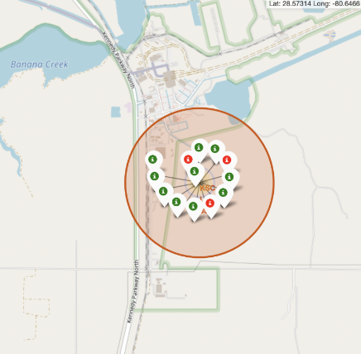
Color-Labeled Launch Records
Explanation
The color-coded markers make it easy to identify launch sites with higher success rates.
Green markers indicate successful launches, while red markers indicate failed launches.
Based on the map, launch site KSC LC-39A shows a notably high success rate.

Slide 36
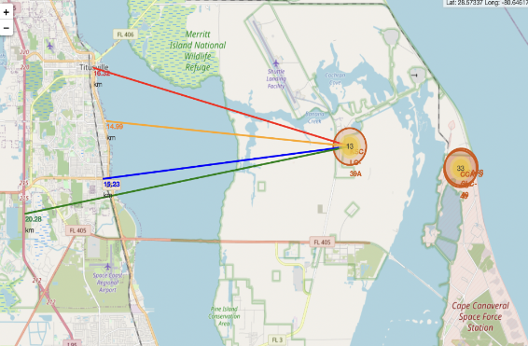
Launch Site Proximities
Explanation
Visual analysis of launch site KSC LC-39A shows that it is located relatively close to nearby infrastructure:
Railway (~15.23 km)
Highway (~20.28 km)
Coastline (~14.99 km)
The site is also relatively close to the nearest city, Titusville (~16.32 km).
In the event of a launch failure, a high-speed rocket could travel significant distances within seconds, posing a potential risk to nearby populated areas.

Slide 37

Section 4

Slide 38
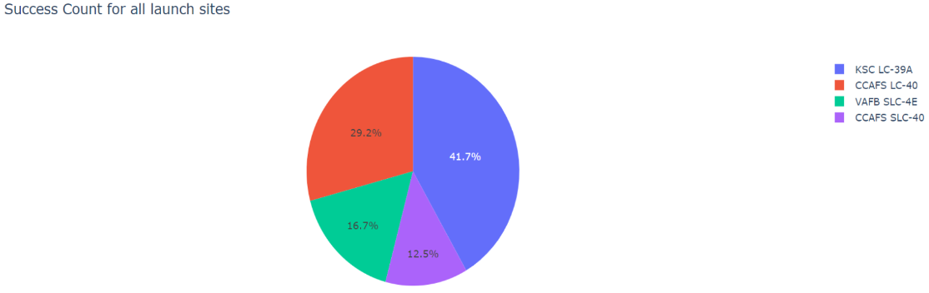
Launch Success Count – All Launch Sites
The chart shows that KSC LC-39A has the highest number of successful launches among all sites.

Slide 39
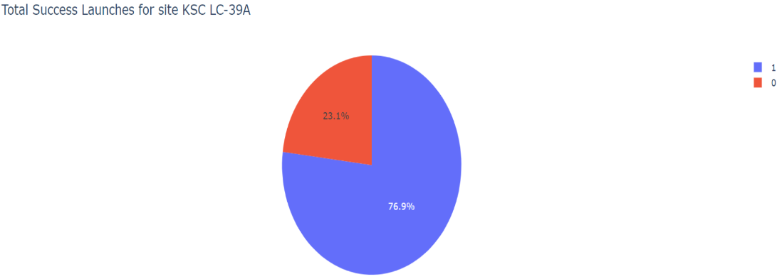
Highest Launch Success Ratio
KSC LC-39A has the highest launch success rate at 76.9%, with 10 successful launches and 3 failed landings.

Slide 40
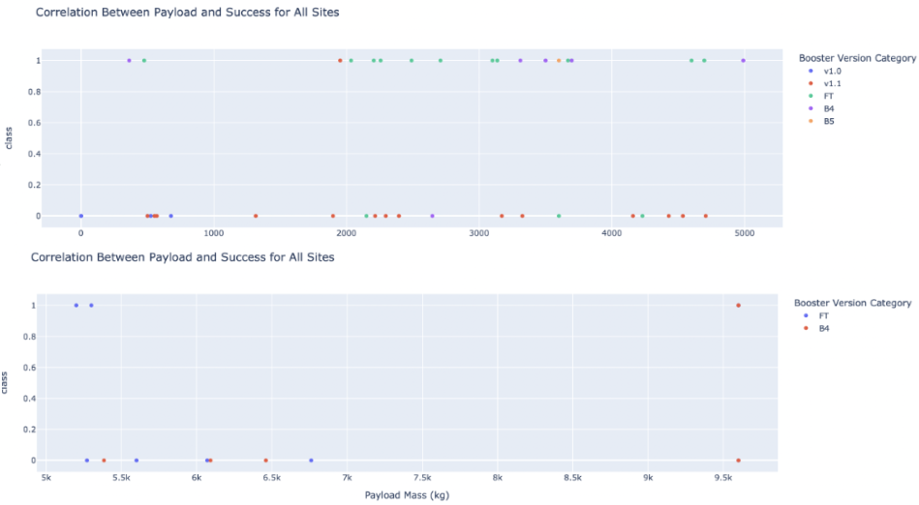
Payload Mass vs. Launch Outcome – All Sites
The charts indicate that payloads between 2,000 and 5,500 kg have the highest success rates.

Slide 41

Section 5

Slide 42
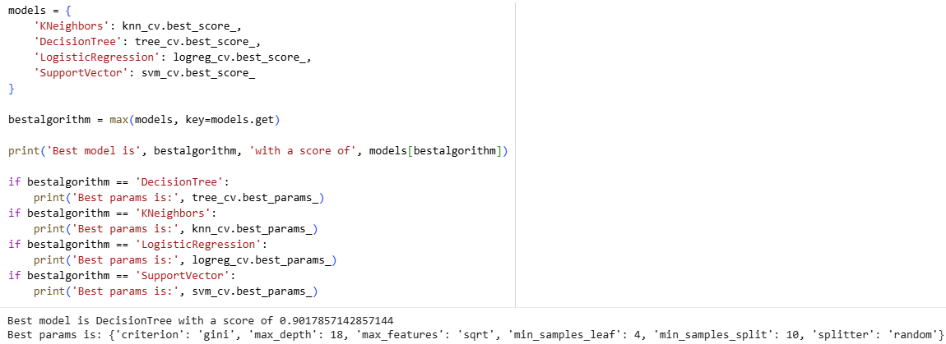
Classification Accuracy
Compared model performance scores and identified the best-performing algorithm along with its optimal hyperparameters.

Slide 43
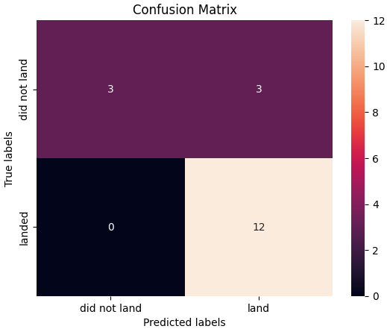
Confusion Matrix
The confusion matrix for the decision tree classifier indicates that the model is generally able to distinguish between the different classes.
The primary issue is the presence of false positives, where the model incorrectly predicts a successful first-stage landing in 3 out of 18 test samples.

Slide 44
Conclusions
Launch sites with a higher number of flights tend to show higher success rates.
Overall launch success rates increased steadily from 2013 through 2020.
Orbits ES-L1, GEO, HEO, SSO, and VLEO achieved the highest success rates, with several showing near-perfect performance.
KSC LC-39A recorded both the highest number of successful launches and the highest overall success rate among all sites.
Launches with lower payload masses generally achieved better success rates than heavier payloads.
Most launch sites are located near the equator and close to coastlines, supporting safer launch trajectories over open water.

Slide 45
Appendix
GitHub Repository with source code files:
https://github.com/plotEZ/IBM-Applied-Data-Science-Capstone
Special thanks to IBM and Coursera for project guidance.

Slide 46


